Slide 1


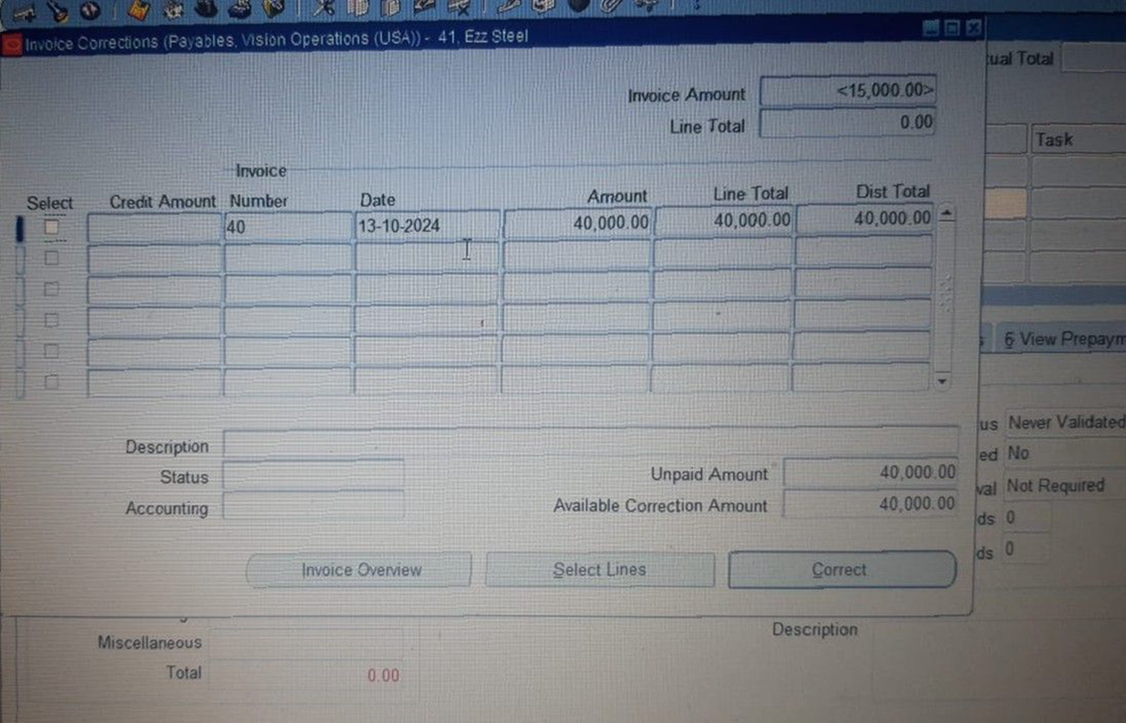
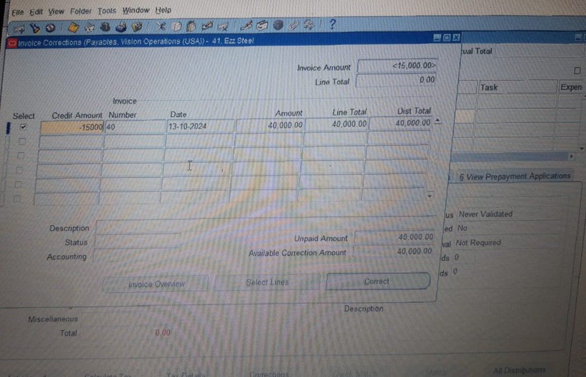
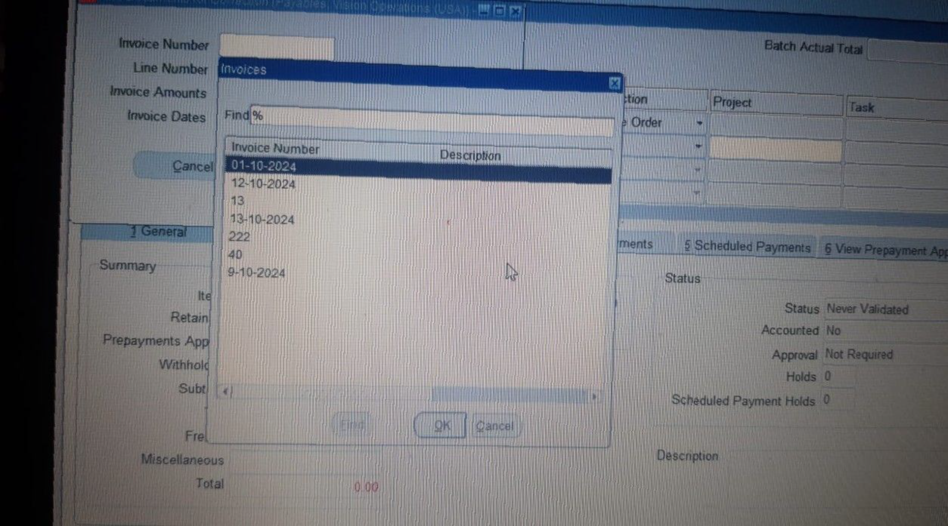
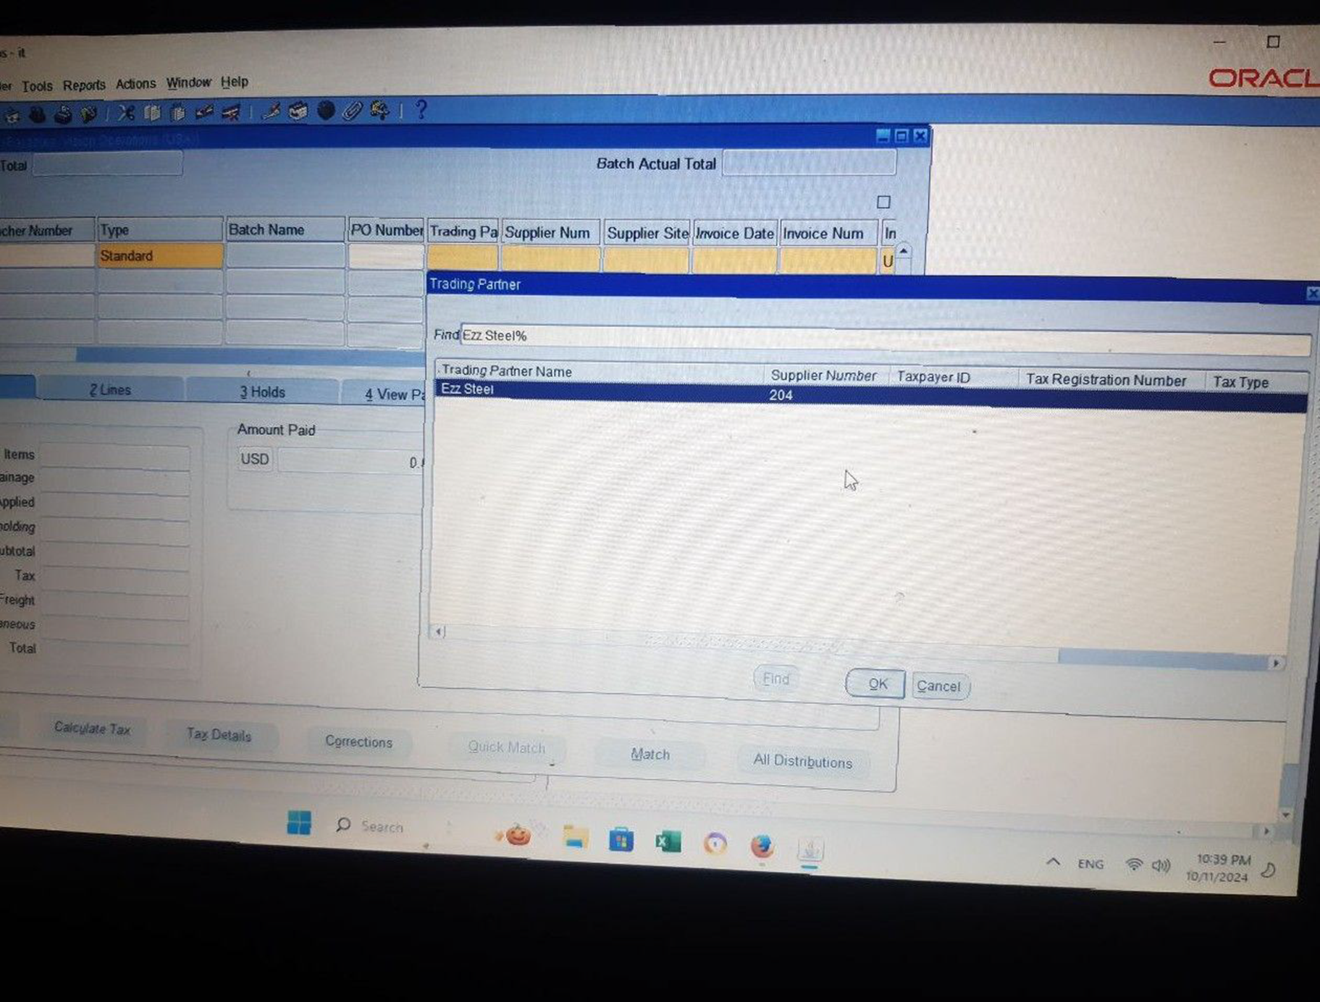
Create and Manage Supplier Invoices
Creating Invoices​
Trading Partner [Ezz Steal ] then OK
Find + the number of Invoice then OK
Click the Select then enter the Credit Amount
Click Correct > OK
19

